Slide 1
CIS Foundations of Machine Learning
Chapter 5
Data Preprocessing
Data Visualization

Slide 2
Outline
Data Preprocessing (Part I)
Normalization of numerical attributes
How to handle Categorical Variables
Data Visualization
Principle of good data visualization
Common data visualization toolbox
Advanced type of data visualizations
How to avoid misuse of visualizations
Show case of good visualizations

Slide 3
Outline
Data Preprocessing (Part I)
Normalization of numerical attributes
How to handle Categorical Variables
Data Visualization
Principle of good data visualization
Common data visualization toolbox
Advanced type of data visualizations
How to avoid misuse of visualizations
Show case of good visualizations

Slide 4
Data Preprocessing (boring but a critical step)
Data Preprocessing Part I
Identify and fixing missing values
Removing outliers
Normalize numerical attributes
Turning categorical variables into numerical values
Data Preprocessing Part II
Data Augmentation
Principal Component Analysis (identifying set of orthogonal vectors)
Features Engineering
Embedding of text

Slide 5
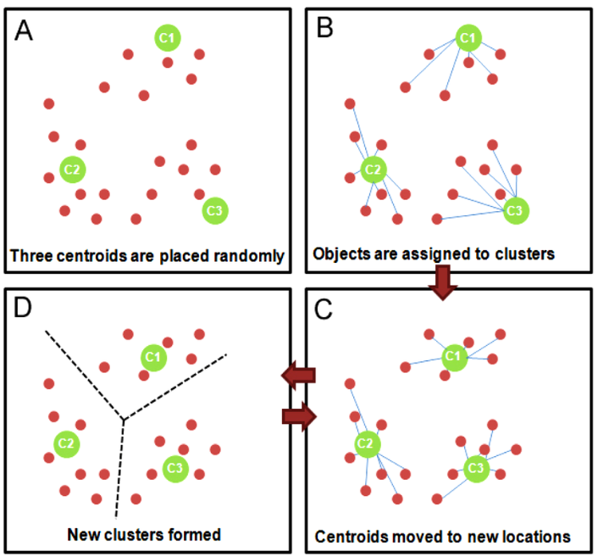
Normalization of Numerical Attributes
In K-means clustering algorithm, we define a similarity measure by using Euclidean distance in the feature space.
We then find clusters of data points by identifying groups of data points whose distance among members of the same cluster to be as small as possible

Slide 6
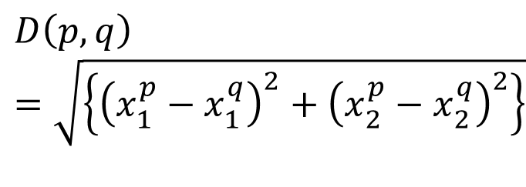
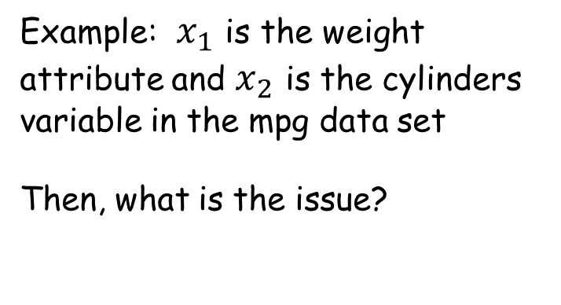
Normalization of Numerical Attributes
$$D\left(p,q\right)=\sqrt{\left\{{\left(x_{1}^{p}−x_{1}^{q}\right)}^{2}+{\left(x_{2}^{p}−x_{2}^{q}\right)}^{2}\right\}}$$
Example: $x_{1}$ is the weight attribute and $x_{2}$ is the cylinders variable in the mpg data set
Then, what is the issue?
The cylinders variable will have no impact on determining whether two cars are considered similar or not.
Solution is to normalize the variables to similar scale

Slide 7
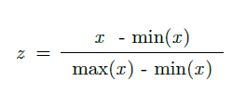
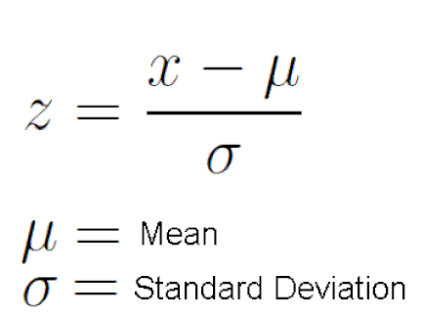
Data Normalization
Normalization or scaling refers to bringing all the columns into similar range.
Two common ways:
Min-Max normalization
Z-score normalization

Slide 8
How to handle Categorical Variables
There are in general two kinds of attributes: numerical and categorical
Example of categorical variables:
Sex and Smoker in the Tips data set
Region in the Car Crash data set
Question: How to include categorical as a factor in model that only accept numerical values (such as linear regression or the K-means clustering)?
Answers: Two ways
Ordinal values
One-hot encoding (sometimes refers to as dummy variables or indicator variables)
Ordinal values is not recommended; Dummy variables and One-hot encoding give the same results, so either is fine with one-hot encoding being preferable

Slide 9
Ordinal Value versus One-hot encoding versus Dummy Variables
Example: Education attribute of a person. It can take
“primary”, “high-school”, “college”, “master”, “Ph.D.” as possible values
Then in Ordinal Value will simply map them into ordinal value such as 1, 2, 3, 4 and 5, i.e. primary becomes 1, high-school becomes 2, …, Ph.D. becomes 5.
However, the system can map Ph.D to be 1, high-school to be 2, primary to be 3 etc.
One categorical column turns into one numerical column
In One-hot encoding, we create N additional columns, each one of them correspond to each possible choices of the categorical variable.

Slide 10
Ordinal Value versus One-hot encoding versus Dummy Variables
Always prefer one-hot encoding although it expand the data frame to much greater number of features
Reason is the numerical relationship in the ordinal values does not usually represent meaningful relative importance of the different choices in a categorical variable
Example: In the education example, say, we map Ph.D to 5 and primary education to 1. However, an education of Ph.D. does not necessarily mean its impact should be 5 times more than a primary education.
The ordinal value assignment is too arbitary

Slide 11
Data Preprocessing Part I
Learning by doing

Slide 12
Outline
Data Preprocessing (Part I)
Normalization of numerical attributes
How to handle Categorical Variables
Data Visualization
Principle of good data visualization
Common data visualization toolbox
Advanced type of data visualizations
How to avoid misuse of visualizations
Show case of good visualizations

Slide 13
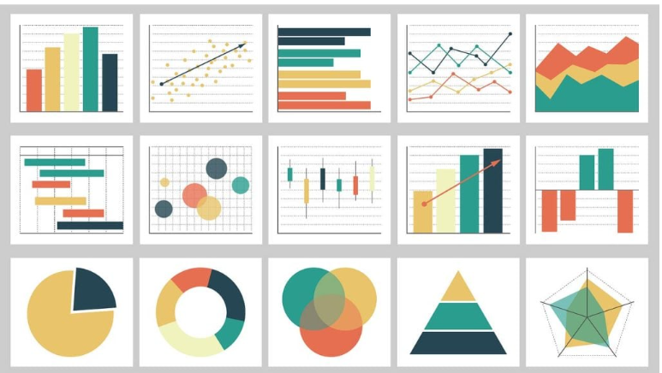
What do you think of when the word Data Visualization is mentioned?

Slide 14
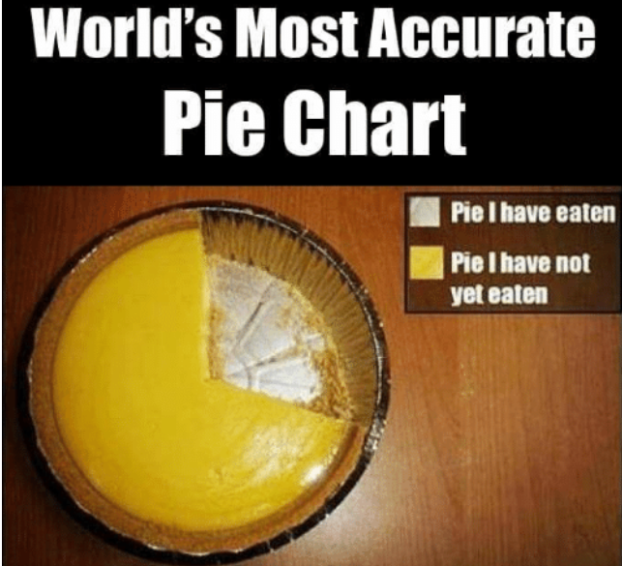
What is the most accurate Pie Chart?

Slide 15
What do you think of when the word Data Visualization is mentioned?
Why?

Slide 16
Data Visualizations
Pictures worth a thousand word
Human brain is good at understanding information conveyed through visualizations than just text and numbers

Slide 17
Principle of good Data Visualizations
Serve a reasonably one single clear purpose
Don’t over-complicated your graphs
Encourage viewer to compare different pieces of data
Induce viewer to think of the substance of data
Avoid distorting what the data have to say
Show the data with easy-to-understand scale
Reveal the data at several levels of detail

Slide 18
Data Visualizations Toolbox
Libraries
Matplot lib
Pandas plot
Seaborn
Plotly
Geographic plots
Type of Plots
Pie Chart / Bar Chart
Scatter Plots
Distribution Plots
Box Plots
FacetGrid
Heatmap
More Advanced visualizations
Geographical Maps (KML)
Interactive Plots
Dash
D3
3D plots
Folium

Slide 19
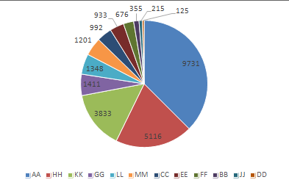
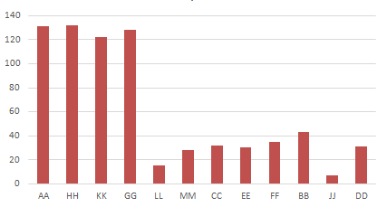
Basic Business Data Visualization
Revenue by Products
Orders by Products

Slide 20
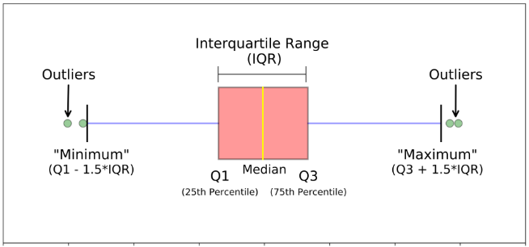
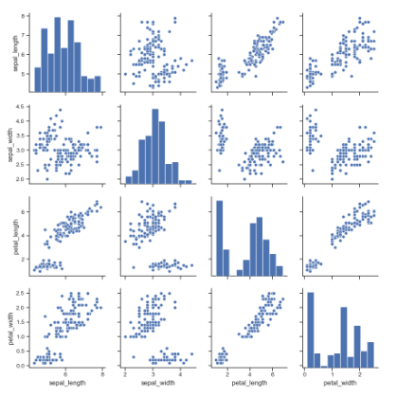
Common Plot type
Pairs Plot
Box Plot

Slide 21
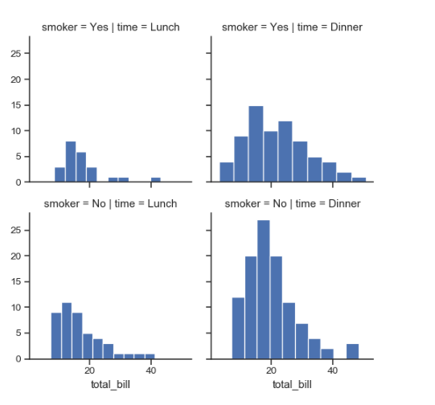
Common Plot type
FacetGrid
Tips data set
Total_bill
Smoker = Yes or No
Time = Dinner or Lunch

Slide 22
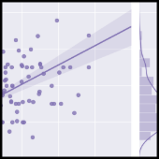
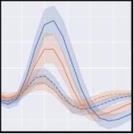
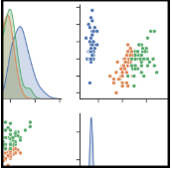
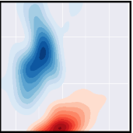
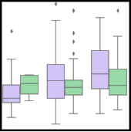
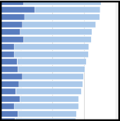
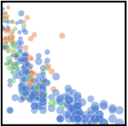
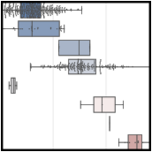
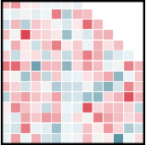
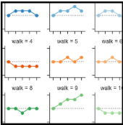
More advanced Types of Visualizations

Slide 23
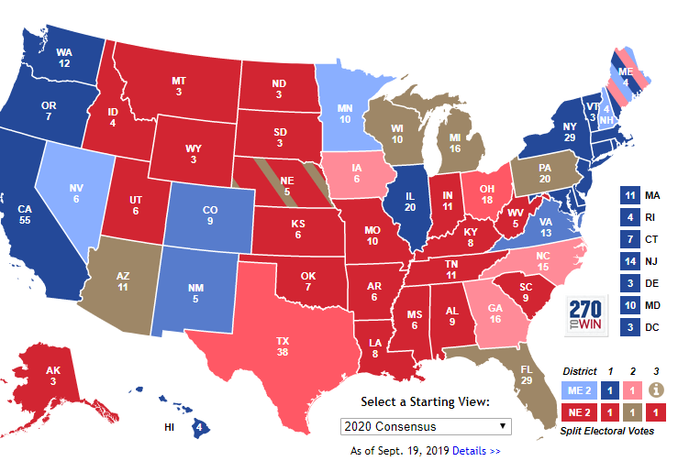
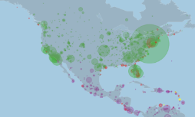
More advanced Types of Visualizations
Geographical Data Visualizations
Google Map
Folium Python library (pip install folium) https://python-visualization.github.io/folium/quickstart.html
KML (pip install simplekml) https://pypi.org/project/simplekml/
Google Earth
https://www.google.com/earth/versions/#earth-pro

Slide 24
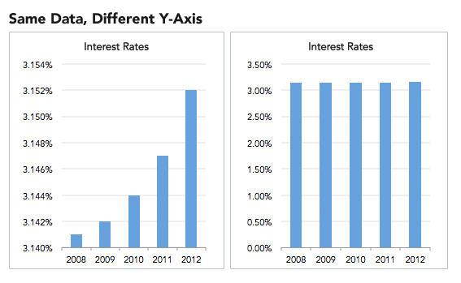
How to misuse or even lie with Data Visualization
Mess around with your scale in the axis

Slide 25
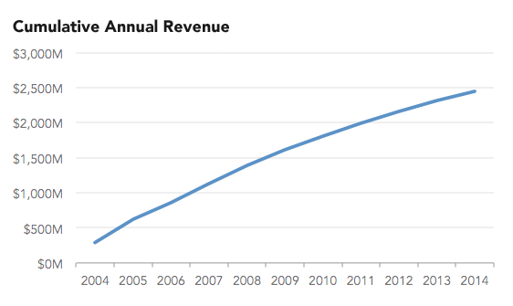
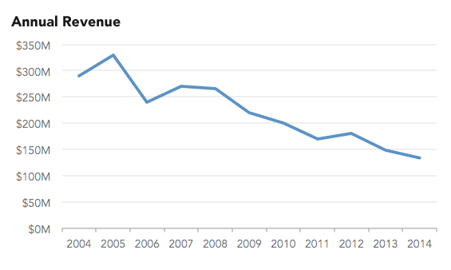
How to misuse or even lie with Data Visualization
Use Cumulative graph

Slide 26
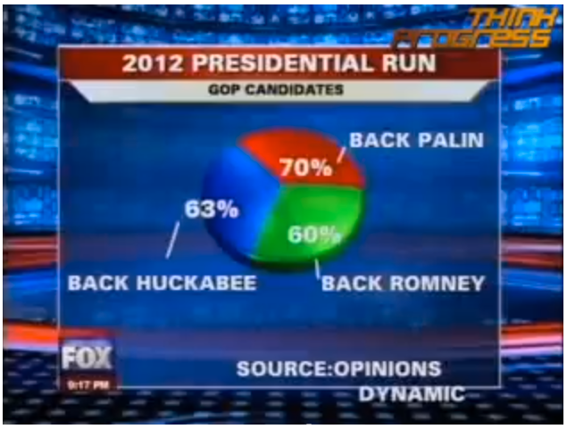
How to misuse or even lie with Data Visualization
Ignore convention

Slide 27
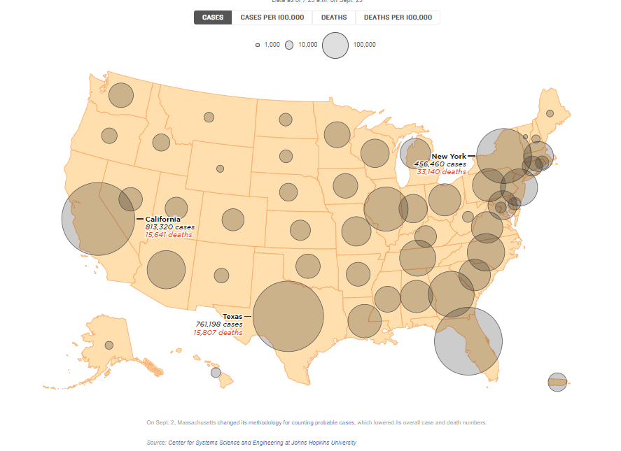
How to misuse or even lie with Data Visualization
Date 1
Date 2 looks like nothing had changed, but in fact the numbers had changed because the scale has changed.
e.g. same circle represents 120,000 instead of 100,000

Slide 28
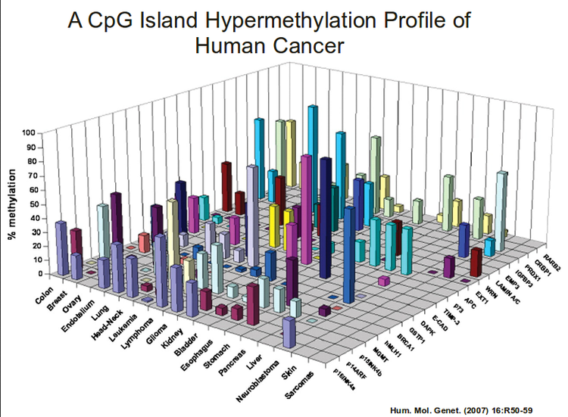
Bad way to tell a story from Data Visualization
Criteria for a bad plot:
Take more than 10 min to understand and get the takeaway from the plot
Storytelling with Data
https://www.amazon.com/Storytelling-Data-Visualization-Business-Professionals-ebook/dp/B016DHQSM2

Slide 29
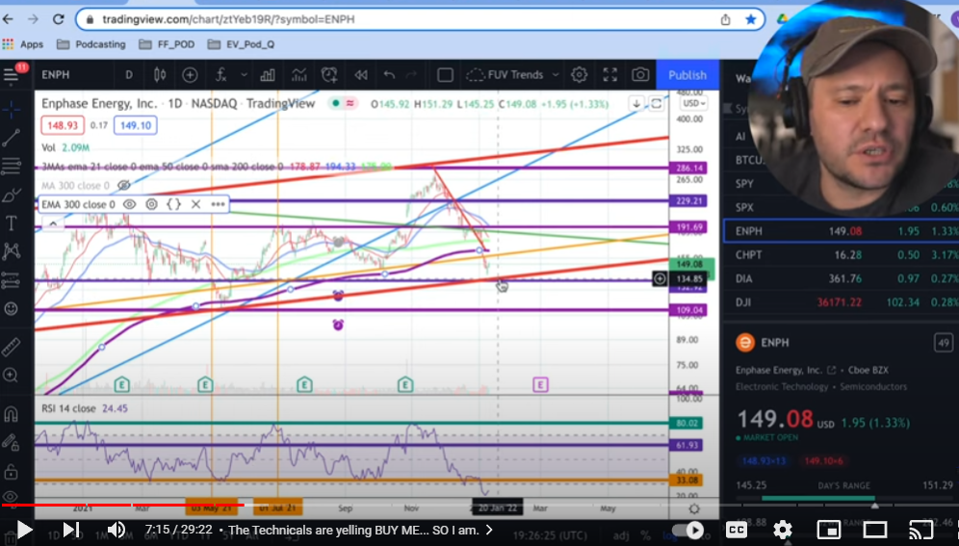
Another example of how to drive your audience crazy

Slide 30
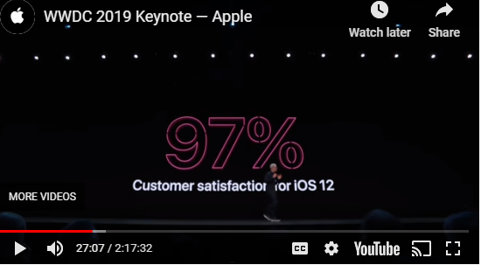
The other extreme
Tim Cook and other Apple leaders use this clever presentation hack to make their slides memorable — and they borrowed it from Steve Jobs
When Apple CEO Tim Cook began talking about a new release of Apple's mobile operating system (iOS 13), he said: "iOS has the highest customer satisfaction in the industry, with an incredible 97%." The slide had one number in large font — 97%. In smaller font beneath the number, a sentence read: "Customer satisfaction for iOS 12.“ That's it. One number and one sentence.
https://www.businessinsider.com/apples-leaders-use-this-presentation-hack-to-make-slides-memorable-2019-6?utm_content=buffer5934a&utm_medium=social&utm_source=facebook.com&utm_campaign=buffer-bi

Slide 31
Showcase of how to use Data Visualization
Hans Rosling: Master of Data Visualizations
Simple dataset of Lifespan versus Income from different country with only 4 columns:
Country, Population, Income, Lifespan
Do people in high income countries live longer?
What are the typical lifespan for high income countries
How does US compare with other countries?
Does country with bigger population change the relationship between lifespan and income?
https://www.gapminder.org/answers/how-does-income-relate-to-life-expectancy/

Slide 32





Data Visualization is useful and important, but
Data
Present visually
Sorted
Explained with a story
Arranged

Slide 33
Additional Data Visualization sample
Hans Rosling: Master of Data Visualizations
TED talk on Public health and longevity
https://www.youtube.com/watch?v=hVimVzgtD6w
(starts from 6:00 to 10:00)
Income disparities
https://www.youtube.com/watch?v=DoSTNRhoceY
https://www.youtube.com/watch?v=AdSZJzb-aX8Ed/PBS
Accenture talk at CWRU
http://www.youtube.com/watch?v=qprHlIzhgUk .

Slide 34
Data Visualizations Toolbox
Learning by doing

